Slide 1

Data Management 2: ETL Workflow and Data Analysis
Rohan Raj (11011896)

Slide 2
Outline
Introduction
Data Profiling
ETL Workflow
Product Analysis
Conclusion

Slide 3
Introduction
Variable | Value | Data Type | Missing Count
Customer_ID | continuous | integer | 0
Customer_LastName | nominal | string | 1553
Customer_Middle | nominal | string | 484621
Customer_Name | nominal | string | 1103
Employee_ID | continuous | integer | 223
Employee_Lastname | nominal | string | 9157
Employee_Middle | nominal | string | 4793
Employee_Name | nominal | string | 9130
ProductID | continuous | integer | 46
Product_Name | nominal | string | 521
Product_Price | nominal | string | 358
Quantity | nominal | string | 22
Sales_ID | continuous | integer | 0
Dataset: Clothing Sales Data
Format: CSV
13 Columns
1 Million~ observations
Notes:
Employee Master data – EmployeeID, Employee’s First, Middle and last name.
Customer Master data – CustomerID, Customer’s First, Middle and last name.
Product data – ProductID,ProductName,ProductPrice.
Transaction data – Sales ID, Quantity.

Slide 4
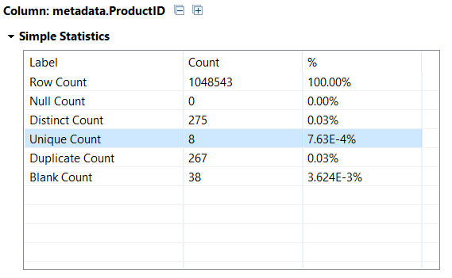

Data Profiling
Simple statistics
Data type and Pattern
Notes:
Nominal Analysis:
Top 10 Customer who purchased the product can be seen using the Frequency table and top 10 most product sold list.
Product ID has some Unique values, these values appear only once in the observation. Values can be valid or invalid. But after viewing the value, one can tell its invalid for ProductID column.

Slide 5
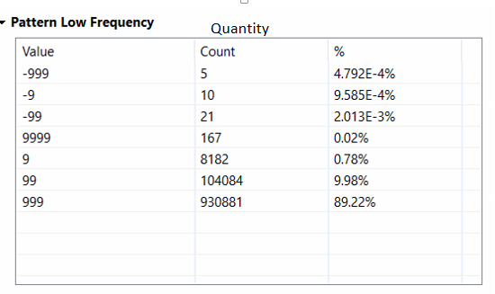
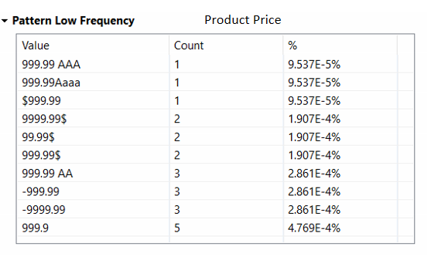
Data Profiling
Quantity
Product Price
Notes:
ProductID has Integer Data Type with range 1-999. There is some value which is inaccurate, it should be of integer type and value is inconsistence.
Quantity column has also Integer Data Type, there are some invalid entries as quantity should be positive only.
Analyzing string lengths of the source data is a valuable step in selecting the most appropriate data types and sizes in the target database.

Slide 6
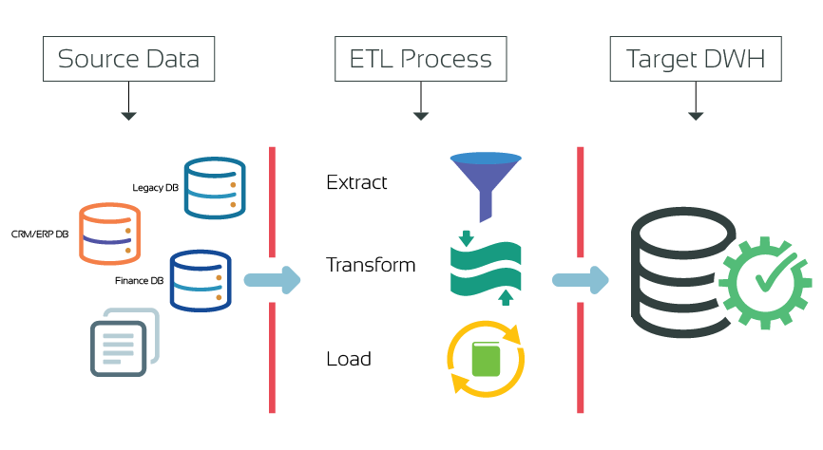
ETL Workflow
Notes:
Now we have looked a data little bit, lets see the ETL workflow

Slide 7
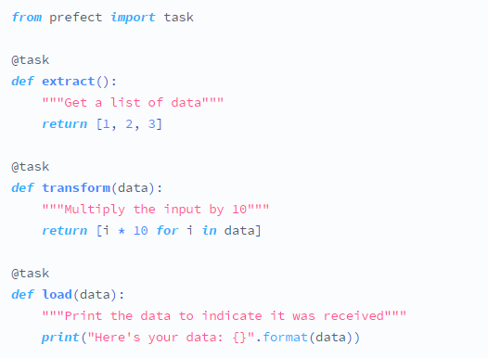
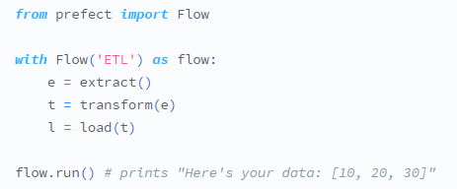
ETL Process with Prefect
Customizable transformations
Passing data between tasks
Computational graph
Notes:
Other frameworks have flexible sources and sinks, but lack the ability to write totally customizable transformations
Large data objects : as long as it fits in memory, Prefect can handle it with no special settings. If it doesn't, there are ways to distribute the operation across a cluster.
we create a Flow and call the tasks just as if they were functions

Slide 8
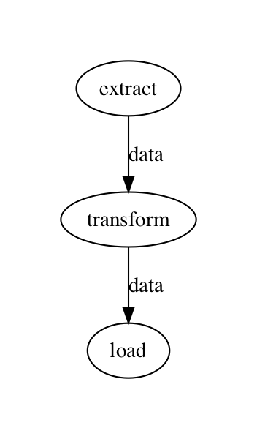
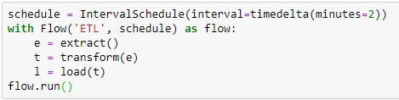
ETL with Python and Prefect
In the background, Prefect is generating a computational graph that tracks all dependencies between our tasks.
Schedule flow

Slide 9
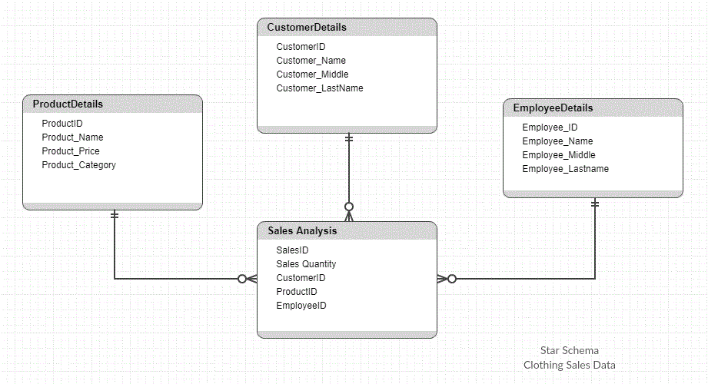
Star Schema
Notes:
Star schema stores data in a dimensional fashion in order to provide user a better experience by providing faster and simpler query performance
In a dimensional model, data resides in a fact table or dimension table.

Slide 10
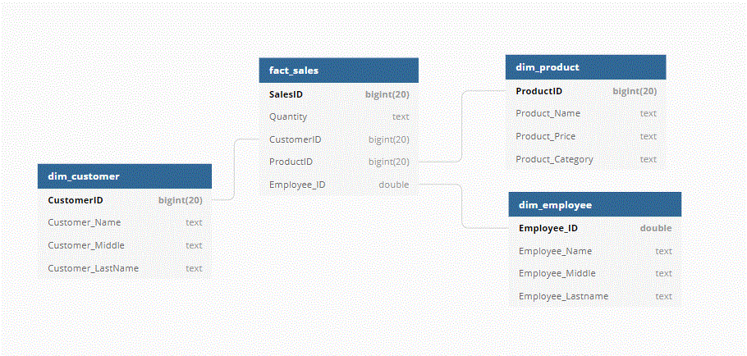
Star Schema
Notes:
Star schema stores data in a dimensional fashion in order to provide user a better experience by providing faster and simpler query performance
In a dimensional model, data resides in a fact table or dimension table.

Slide 11
Slowly changing dimension
Dimensions contain relatively static data
Implementation of SCD (Slowly Changing Dimension), Type 1
pygrametl provides simplest abstraction to interact with dimensions
Notes:
static data: entities as geographical locations, customers, or products, employee
Transaction/sales data: more frequent

Slide 12
Classification Problem
The problem at hand is to classify products to their most appropriate category.
Category (Bikes) and sub-category (Mountain, Road)
KNeighborsClassifier and RadiusNeighborsClassifier
Notes:
While this categorization works well on retailer websites, it becomes an issue for ecommerce aggregator
KDtree

Slide 13


DEMO

Slide 14
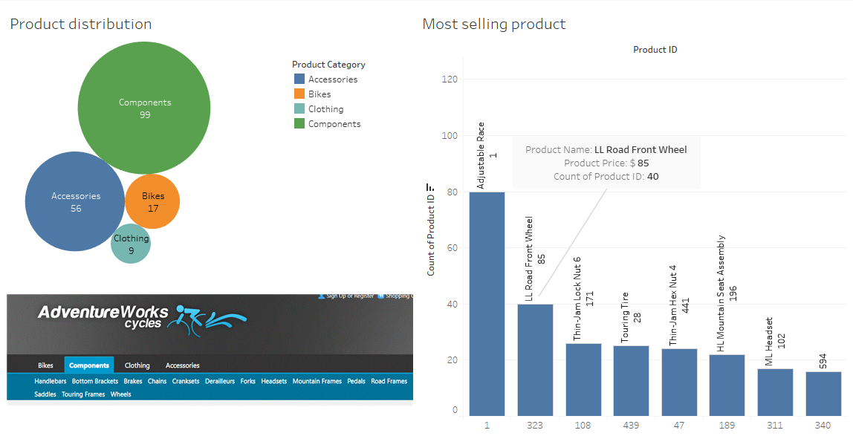
Product Analysis

Slide 15
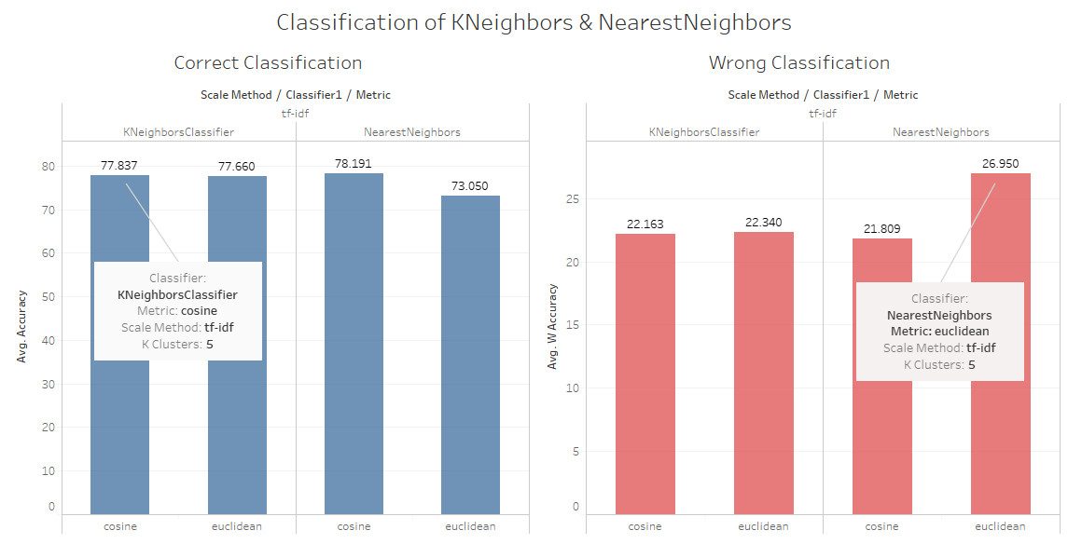
Classification Result

Slide 16
References
Dataset Related information https://demos.componentone.com/aspnet/adventureworks/Products.aspx
Prefect Library https://docs.prefect.io/core/tutorials/etl.html
Pygrametl https://chrthomsen.github.io/pygrametl/doc/examples/dimensions.html
4. Classification https://github.com/gallib2/product-categorization

Slide 17


Thank you

